Slide 1
CPS-101 ICT Fundamentals
Lecture - 5
Lecturer Rabia Khan

Slide 2
Topics covered...
Functions of Operating System
Types of Operating System
Enhancing OS
BIOS
Functions of BIOS

Slide 3
Operating System
An operating system creates the ability to:
  serve a variety of purposes
  interact with users in more complicated ways
  keep up with needs that change over time
All desktop computers have operating systems. The most common are the Windows family of operating systems developed by Microsoft, the Macintosh operating systems developed by Apple and the UNIX family of operating systems (which have been developed by a whole history of individuals, corporations and collaborators).

Slide 4
Functions of OS
It manages the hardware and software resources of the system.
  In a desktop computer, these resources include such things as the processor, memory, disk space and more (On a cell phone, they include the keypad, the screen, the address book, the phone dialler, the battery and the network connection).
It provides a stable, consistent way for applications to deal with the hardware without having to know all the details of the hardware.

Slide 5
Types of Operating Systems
Real-time operating system
  Very fast small OS
  If programmed correctly, an RTOS can guarantee that a program will run with very consistent timing.
  General OS like Windows are designed to smoothly run many programs and services at once, while real-time operating systems are typically designed to run one application very reliably and with precise timing
  Built into a device
  Respond quickly to user input
  MP3 players, Medical devices
  Examples are Chimera, Lynx etc

Slide 6
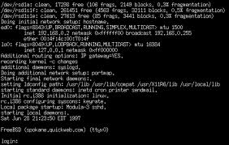
Types of Operating Systems
Single user/Single tasking OS
  One user works on the system
  Performs one task at a time
  MS-DOS and Palm OS
  Take up little space on disk
  Run on inexpensive computers

Slide 7
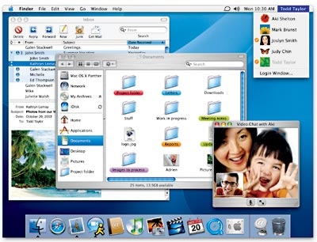
Types of Operating Systems
Single user/Multitasking OS
  User performs many tasks at once
  Most common form of OS
  Windows XP
  Require expensive computers
  Tend to be complex
Notes:
It is true that multi-tasking operating systems are complex. However both XP and OS X make the multitasking process painless for the user.

Slide 8
Types of Operating Systems
Multi user/Multitasking OS
  Many users connect to one computer
  Each user has a unique session
  UNIX, Linux, and VMS
  Maintenance can be easy
  Requires a powerful computer
Notes:
The session of activity that a user with a unique IP address spends on a Web site during a specified period of time.

Slide 9
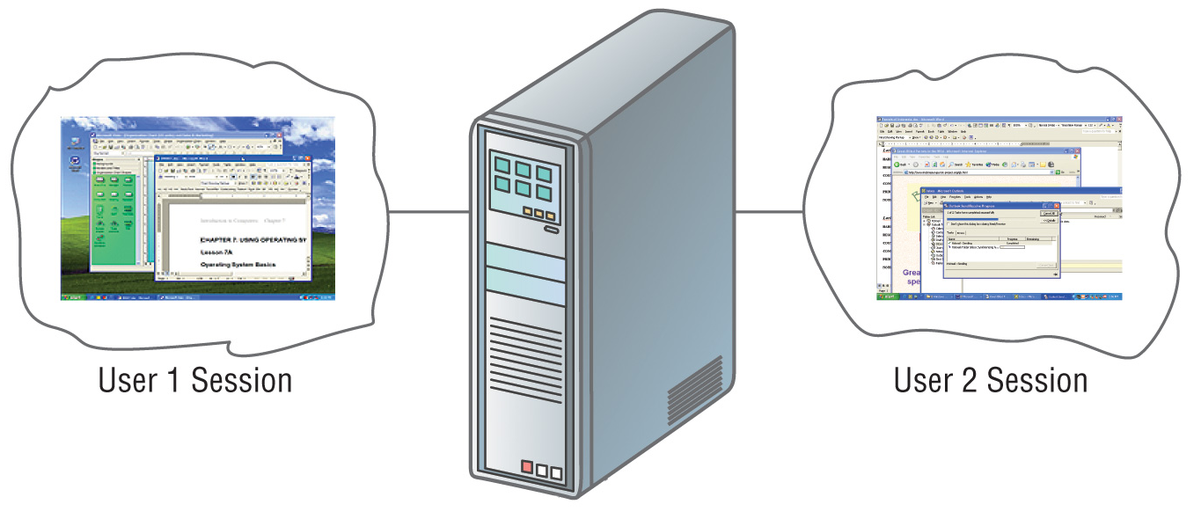
Multi user/Multi tasking OS

Slide 10
Providing a User Interface
Graphical user interface (GUI)
  Most common interface
    Windows, Gnome
  Uses a mouse to control objects
  Uses a desktop metaphor
  Shortcuts open programs or documents
  Open documents have additional objects
  Task switching
  Dialog boxes allow directed input
Notes:
The first commercial GUI was the Xerox Star.

Slide 11
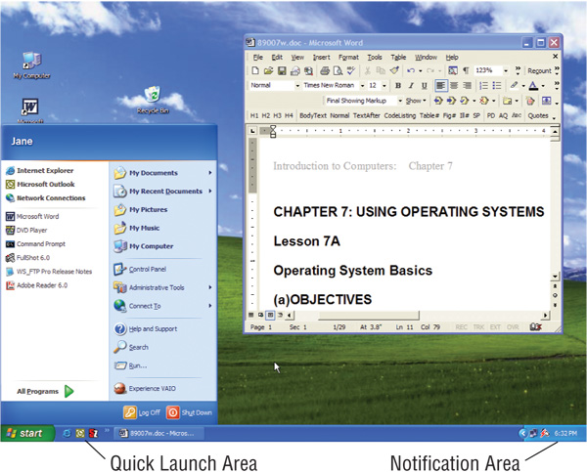
Graphical User Interface

Slide 12
Providing a User Interface
Command line interfaces
  Called Command Driven
  Older interface
    DOS, Linux, UNIX
  User types commands at a prompt
  User must remember all commands
  Included in all GUIs used these days

Slide 13
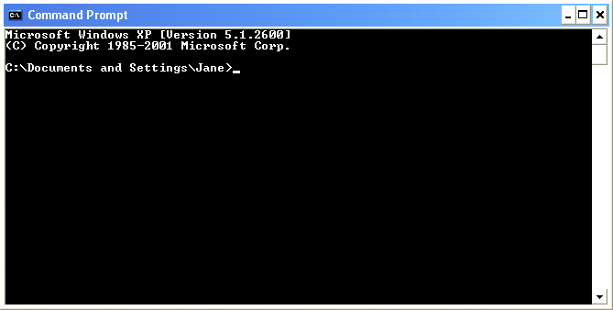
Command Line Interface

Slide 14
Enhancing an OS
Utilities
  Provide services not included with OS
  Goes beyond the four functions
  Firewall, anti-virus and compression
  Prices vary
Notes:
With Windows XP and SP2, Microsoft has included a firewall and pop-up blocker both typically considered utility software. In the near future, the core services provided by an OS may include security features.

Slide 15
Enhancing an OS
Backup software
  Archives files onto removable media
  Ensures data integrity
  Most OS include a backup package
  Many third party packages exist

Slide 16
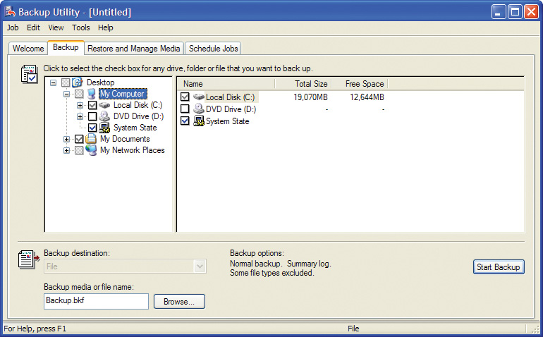
Enhancing an OS- Backup Software

Slide 17
Enhancing an OS
Anti-virus software
  Crucial utility
  Finds, blocks and removes viruses
  Must be updated regularly
  McAfee and Norton Anti-Virus

Slide 18
Enhancing an OS
Firewall
  is a part of a computer system or network that is designed to block unauthorized access while permitting authorized communications. It is a device or set of devices that is configured to permit or deny network transmissions based upon a set of rules and other criteria
  Protects your computer from intruders
  Makes computer invisible to hackers
  Zone Labs is a home firewall
  Cisco sells hardware firewalls
Notes:
Windows XP includes a firewall. Service pack 2 will turn this firewall on by default. To test your computer’s security visit www.grc.com and run the various Shields Up! tests

Slide 19
Enhancing an OS
Intrusion detection
  Often part of a firewall package
  Announces attempts to breach security
  Snort is a Linux based package

Slide 20
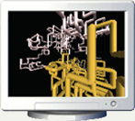
Enhancing an OS
Screen savers
  Crucial utility for command line systems
    A type of computer program initially designed to prevent phosphor burn-in on CRT and plasma computer monitors by blanking the screen or filling it with moving images or patterns when the computer is not in use. Contemporary screensavers are used primarily for entertainment or security.
  Screen saver decorates idle screens

Slide 21
Behind the Scenes....!!
Most people never think about what actually goes on when they do something on the computer. To most people, whenever they command the computer to do something, it just does it. No questions asked !
It isn't as simple as that. Behind the facade of the user-friendly GUI (Graphical User Interface), many things have to be done by the system for the command to be carried out.

Slide 22
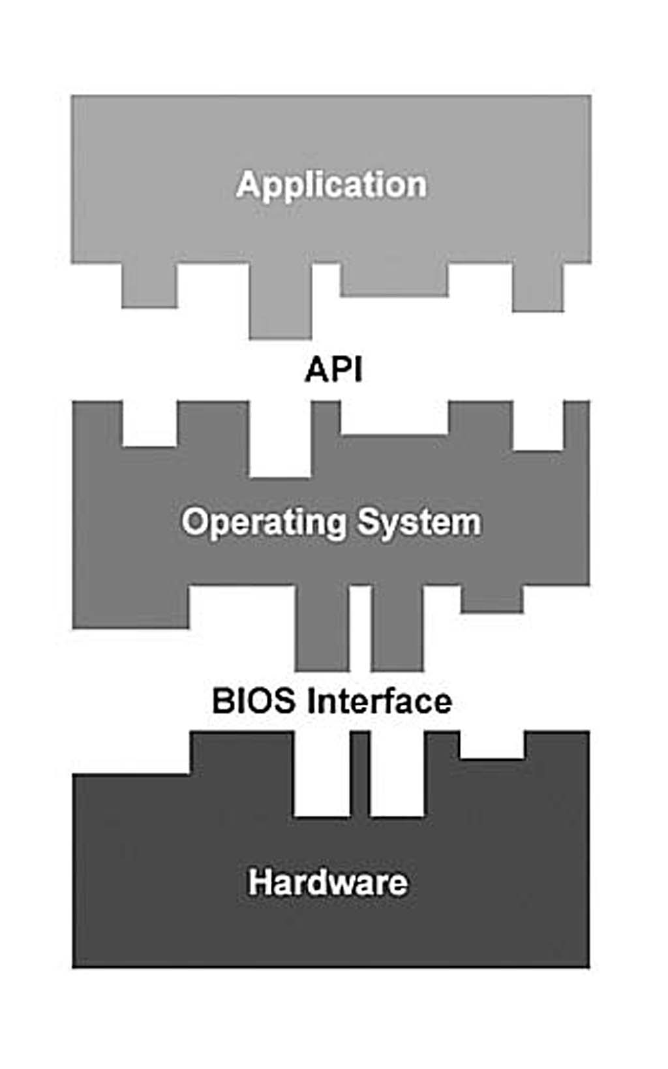
Layered Architecture
The computer system can be visualized as three separate layers that communicate with each other through different interfaces.
In our layered system, the application is the highest level. It cannot directly interact with the hardware. It can only communicate with the operating system through the API or Application Program Interface.

Slide 23
Application Programming Interface (API)
The API is a set of common functions that the application calls upon to get the operating system to do what it wants. Because the API is operating system-specific, it differs from operating system to operating system.
However, irrespective of the operating system, the API allows the application to get the job done without knowing how the operating system does it. The application doesn't need to know anything about the computer's hardware.

Slide 24
Basic Input Output System (BIOS)
The operating system then communicates to the BIOS what it needs to carry out the application's request. The operating system never communicates directly with the hardware.
The BIOS layer allows the operating system to support all manners of hardware. Each piece of hardware comes with its own BIOS and/or driver, which become part of the system's BIOS.
Therefore, the BIOS layer is dynamic and changes to match the computer's hardware configuration.

Slide 25
Importance of BIOS
The operating system only needs to know how to communicate with the BIOS layer. It is up to the BIOS layer to translate the operating system commands into action by the hardware.
Without the BIOS layer, there's no way the operating system can access the hardware layer. The BIOS layer is the operating system's key to the hardware layer. That's how important the BIOS layer is in the computer system.

Slide 26
Breakdown of BIOS Functions
Power-on diagnostic tests
System configuration utility
Bootstrap loader
BIOS interface

Slide 27
Power-On Diagnostic Test (POST)
When you turn on the power to a computer, the first program that runs is usually a set of instructions kept in the computer's read-only memory (ROM). This code examines the system hardware to make sure everything is functioning properly.

Slide 28
System Configuration Utility
After the POST sequence completes, you are given the opportunity to access the system configuration utility. This utility allows you to configure and modify a range of features.
These BIOS features control every aspect of the computer, from the speed at which the processor runs to hard disk information.

Slide 29
Bootstrap Loader
The bootstrap loader is a small program that has a single function:
  It loads the operating system into memory and allows it to begin operation. In the most basic form, the bootstrap loader sets up the small driver programs that interface with and control the various hardware subsystems of the computer. It sets up the divisions of memory that hold the operating system, user information and applications.

Slide 30
Accessing the BIOS Setup Utility
The BIOS setup utility is only available for a few short seconds when you boot up your computer. If your operating system has already loaded up, you must reboot your computer before you can access the BIOS setup utility.
Normally Del, F2 and Esc Keys are used to halt the booting process and brings up the BIOS setup menu.

Slide 31
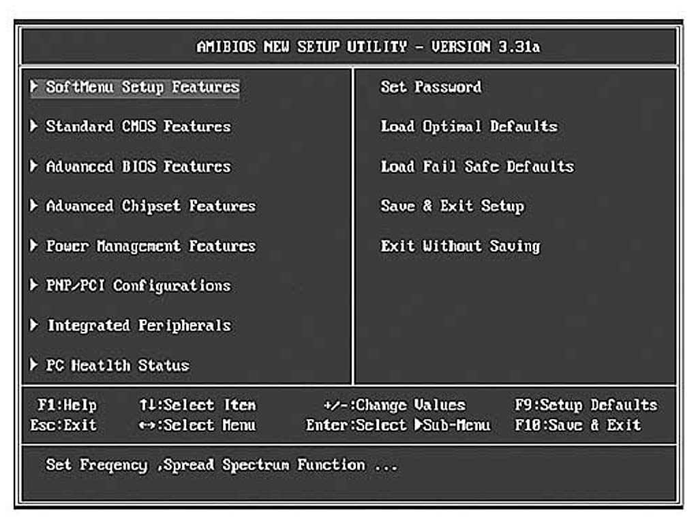
BIOS Setup Utility

